Slide 1
FLOW CHART SYMBOL
START the program
INPUT a value
OUTPUT on console
DECIDE something
PROCESS something
STOP the program

Slide 2
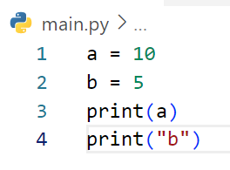
DRAW FLOWCHART
START
a = 10
b = 5
EXAMPLE
Print a
Print “b”
END

Slide 3
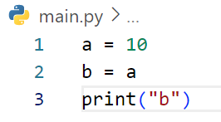
DRAW FLOWCHART
START
a = 10
b = a
Print “b”
END

Slide 4
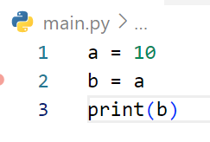
DRAW FLOWCHART
START
a = 10
b = a
Print b
END

Slide 5
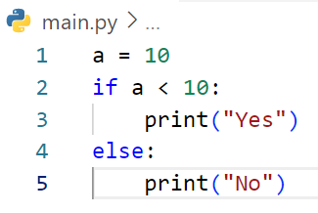
START
DRAW FLOWCHART
EXAMPLE
a = 10
No
a < 10?
Yes
Print “Yes”
Print “No”
END

Slide 6
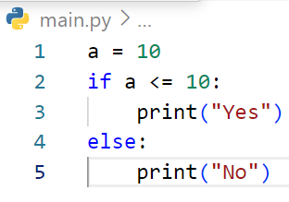
START
DRAW FLOWCHART
a = 10
No
a < =10?
Yes
Print “Yes”
Print “No”
END

Slide 7
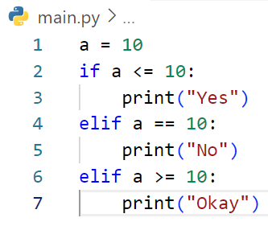
START
DRAW FLOWCHART
EXAMPLE
a = 10
No
a < 10?
a == 10?
No
Yes
Print “Yes”
Yes
a >= 10?
No
Print “No”
Yes
Print “Okay”
END

Slide 8
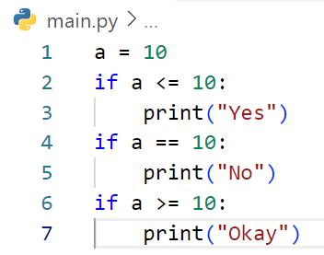
START
DRAW FLOWCHART
a = 10
a < 10?
Yes
Print “Yes”
Yes
a == 10?
Yes
Print “No”
Yes
a >= 10?
Yes
Print “Okay”
END

Slide 9
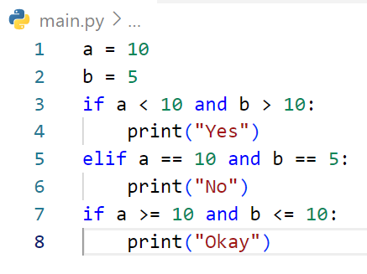
START
DRAW FLOWCHART
a = 10
no
a < 10 and b>10
Yes
Print “Yes”
a == 10 and b>10
Yes
Print “No”
a >= 10 and b<=10
Yes
Print “Okay”
END

Slide 10
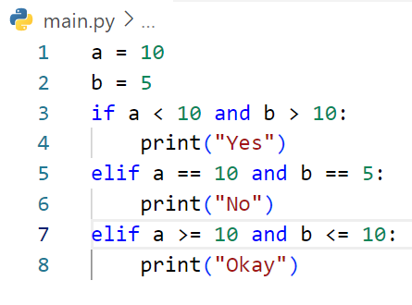
START
DRAW FLOWCHART
a = 10
no
a < 10 and b > 10
Yes
no
Print “Yes”
a == 10 and b== 5
Yes
a >= 10 and b <= 10
Print “No”
Yes
Print “Okay”
END

Slide 11
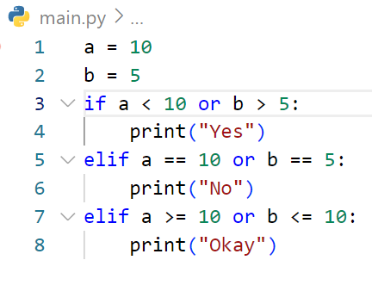
START
DRAW FLOWCHART
a = 10
a < 10 or b >5
no
Yes
no
Print “Yes”
a == 10 or b ==5
Yes
a >= 10 or b<= 10
Print “No”
Yes
Print “Okay”
END

Slide 12
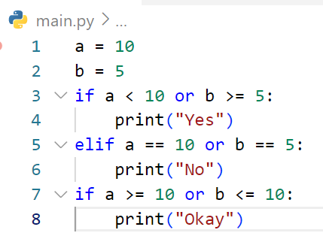
START
DRAW FLOWCHART
a = 10
no
a < 10 or b>= 5
Yes
Print “Yes”
a == 10 or b == 5
Yes
Print “No”
a == 10 or b<=10
Yes
Print “Okay”
END

Slide 13
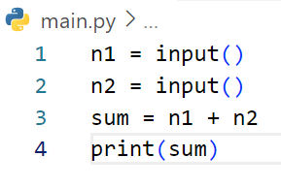
START
DRAW FLOWCHART
Get n1
Get n2
# If user enter first : 3 and second 5
sum = n1 + n2
EXAMPLE
Print sum
END

Slide 14
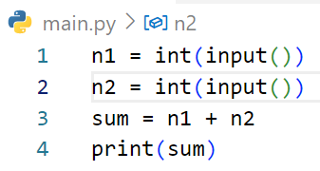
START
DRAW FLOWCHART
Get n1
Get n2
sum = n1 + n2
# If user enter first : 3 and second 5
Print sum
END

Slide 15
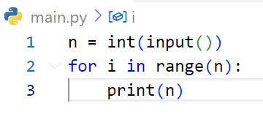
START
DRAW FLOWCHART
Get n
3
EXAMPLE
# If user enter : 3
Done
REPEAT n TIMES
Ongoing
Print n
END

Slide 16
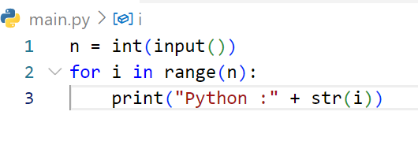
START
DRAW FLOWCHART
Get n
3
# If user enter : 3
Done
REPEAT n TIMES
Ongoing
Print (“Python :” + str(i))
END

Slide 17
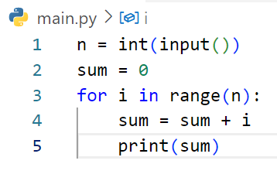
START
DRAW FLOWCHART
Get n
3
Get sum
0
# If user enter : 3
Done
REPEAT n TIMES
Ongoing
Sum = sum + i
Print sum
END

Slide 18
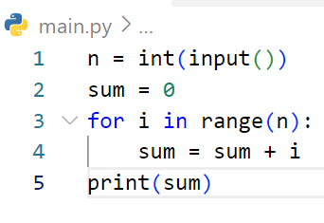
START
DRAW FLOWCHART
Get n
3
Get sum
0
# If user enter : 2
Done
REPEAT n TIMES
Ongoing
Sum = sum + i
Print sum
END

Slide 19
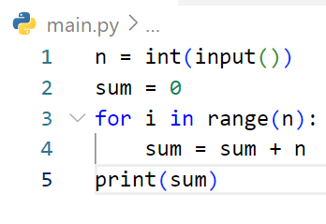
START
DRAW FLOWCHART
Get n
4
Get sum
0
# If user enter : 4
Done
REPEAT n TIMES
Ongoing
Sum = sum + n
Print sum
END

Slide 20
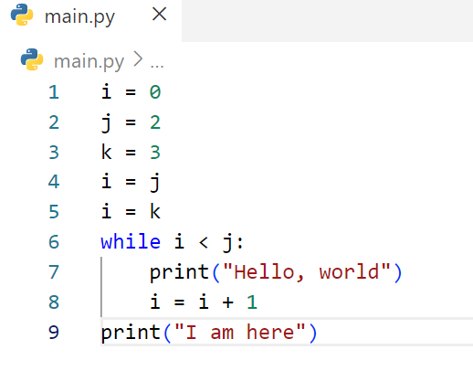
START
DRAW FLOWCHART
i = 0
j =2
k = 3
i = j
i = k
i < j
no
Yes
Print “ Hello, world”
i = i + 1
Print “ I am here”
END

Slide 21
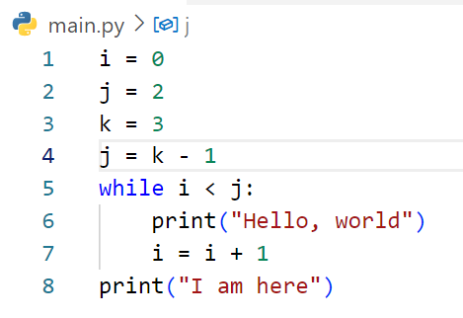
START
DRAW FLOWCHART
i = 0
j = 2
k = 3
j = k - 1
i < j
no
Yes
Print “ Hello, world”
i = i + 1
Print “ I am here”
END

Slide 22
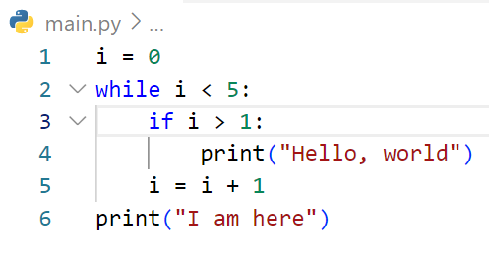
START
DRAW FLOWCHART
i = 0
i < 5
no
i > 1
Yes
Print “ Hello, world”
i = i + 1
Print “ I am here”
END

Slide 23
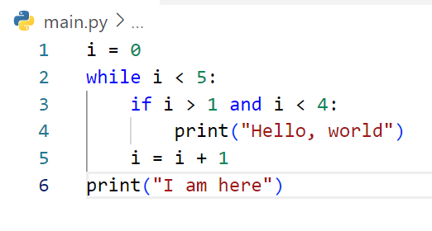
START
DRAW FLOWCHART
i = 0
i < 5
no
i > 1 and i <4
Yes
Print “ Hello, world”
i = i + 1
Print “ I am here”
END

Slide 24
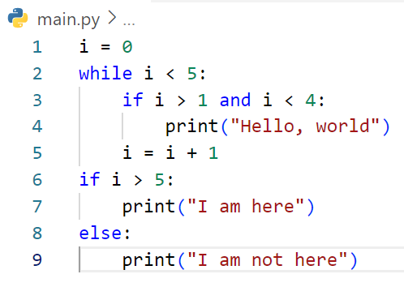
START
DRAW FLOWCHART
i = 0
no
i < 5
Yes
i > 1 and I < 4
Yes
Print “ Hello, world”
i = i + 1
i > 5
no
Yes
Print “ I am here”
Print “ I am not here”
END

Slide 25
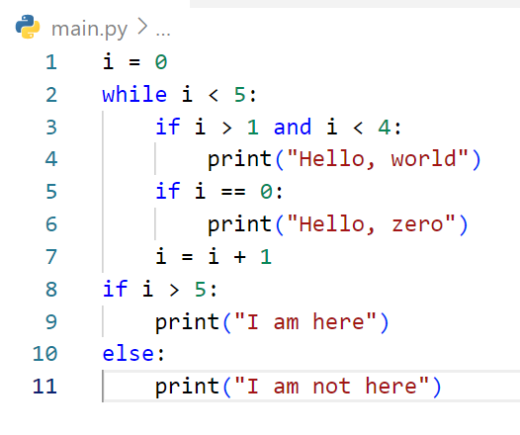
START
DRAW FLOWCHART
i = 0
no
i < 5
Yes
i > 1 and I < 4
Yes
Print “ Hello, world”
i > 1 == 0
Print “ Hello, zero”
i = i + 1
no
i > 5
Yes
Print “ I am here”
Print “ I am here”
END

Slide 26
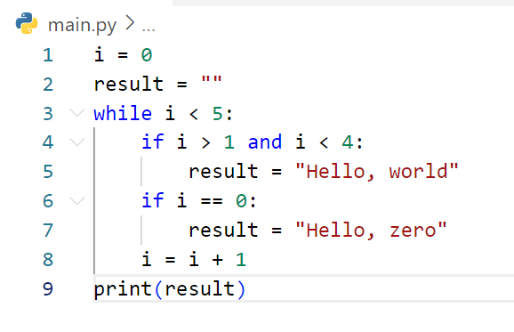
START
DRAW FLOWCHART
i = 0
result = “ “
no
i < 5
Yes
i > 1 and I < 4
Yes
result = “ Hello, world”
i > 1 == 0
result = “Hello, zero”
i = i + 1
Print result
END

Slide 27
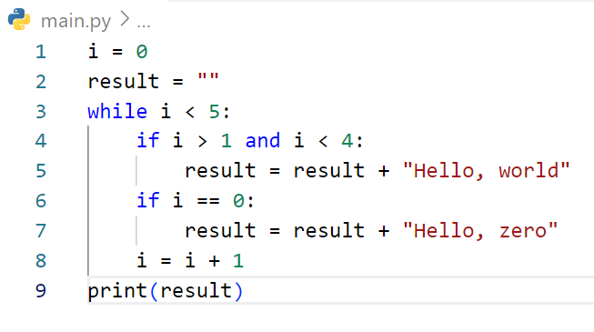
START
DRAW FLOWCHART
i = 0
result = “ “
no
i < 5
Yes
i > 1 and I < 4
Yes
Result += “ Hello, world”
i > 1 == 0
result + = “Hello, zero”
i = i + 1
Print result
END

Slide 28
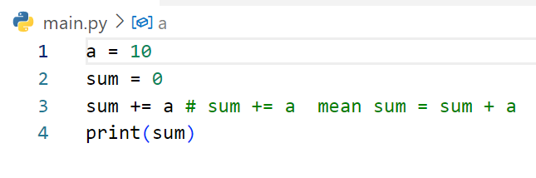
DRAW FLOWCHART
START
A = 10
Sum = 0
Sum += a
Print sum
END

Slide 29
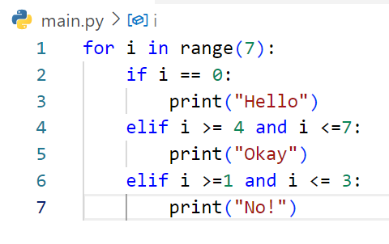
START
DRAW FLOWCHART
Repeat 7
Done
i == 0
i >= 4 and I <= 7
Print “Hello”
I >=1 and I <=3
Print “Okay”
Print “No”
END

Slide 30
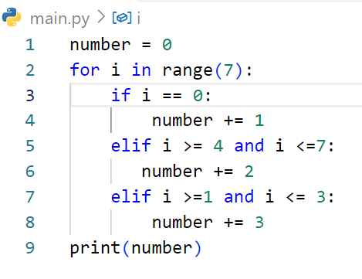
START
DRAW FLOWCHART
Repeat 7
Done
i == 0
Number += 1
i >= 4 and I <= 7
I >=1 and I <=3
Number += 2
Number += 3
Print number
END

Slide 31
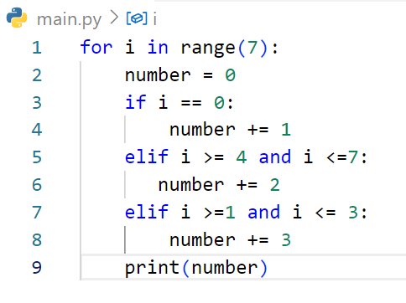
START
DRAW FLOWCHART
Repeat 7
Done
Number = 0
i == 0
i >= 4 and I <= 7
Number += 1
I >=1 and I <=3
Number += 2
Number += 3
Print number
END

Slide 32
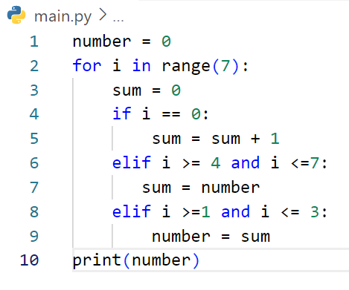
START
DRAW FLOWCHART
Repeat 7
Done
sum = 0
i == 0
i >= 4 and I <= 7
sum += 1
I >=1 and I <=3
sum = number
number = sum
Print number
END

Slide 33
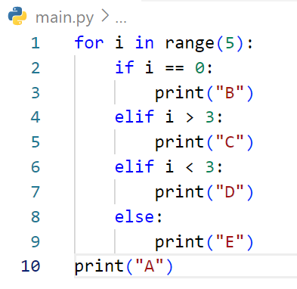
DRAW FLOWCHART

Slide 34
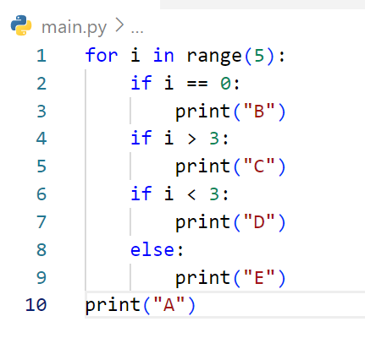
DRAW FLOWCHART

Slide 35
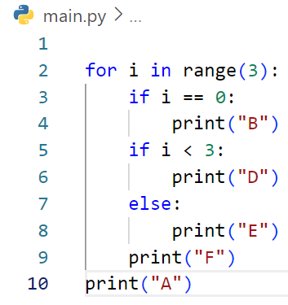
DRAW FLOWCHART

Slide 36
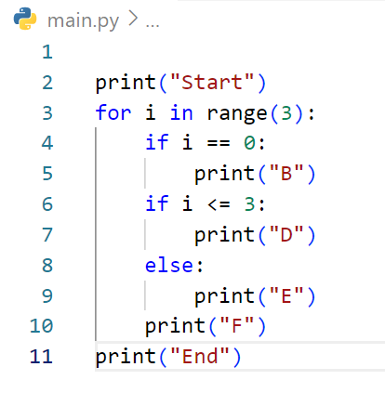
DRAW FLOWCHART

Slide 37
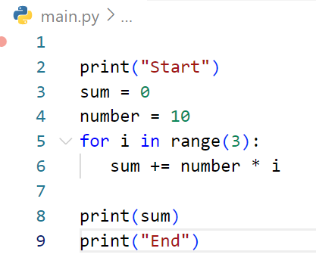
DRAW FLOWCHART

Slide 38
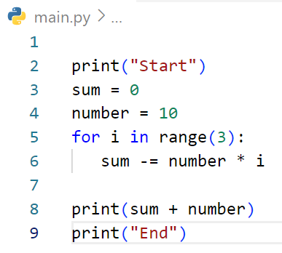
DRAW FLOWCHART

Slide 39
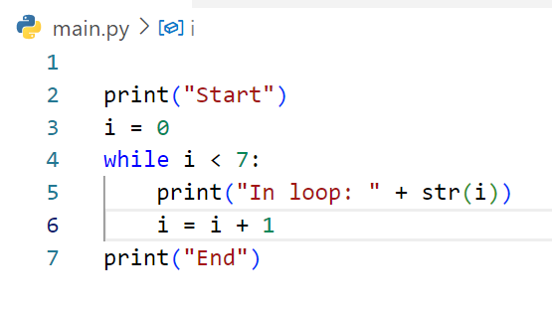
DRAW FLOWCHART

Slide 40
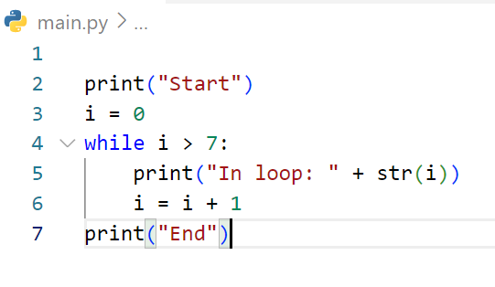
DRAW FLOWCHART

Slide 41
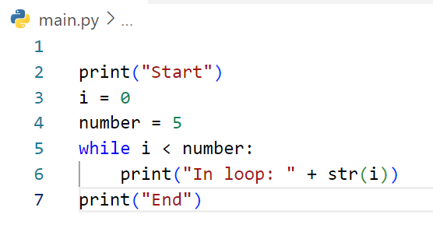
DRAW FLOWCHART

Slide 42
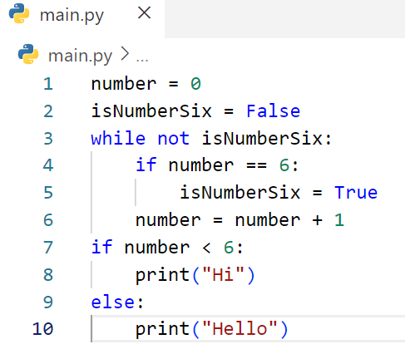
DRAW FLOWCHART

